Slide 1
MODULE 5
BACKUP AND RECOVERY
GELIL DAVID S. GALANG
Instructor I

Slide 2
What is a Backup?
Backup is an additional copy of data that can be used for restore and recovery purposes
The Backup copy is used when the primary copy is lost or corrupted
This Backup copy can be created by:
  Simply coping data (there can be one or more copies)
  Mirroring data (the copy is always updated with whatever is written to the primary copy)
Notes:
Copyright © 2009 EMC Corporation. Do not Copy - All Rights Reserved.

Slide 3
It’s All About Recovery
Businesses back up their data to enable its recovery in case of potential loss
Businesses also back up their data to comply with regulatory requirements
Backup purposes:
  Disaster Recovery
    Restores production data to an operational state after disaster
  Operational
    Restore data in the event of data loss or logical corruptions that may occur during routine processing
  Archival
    Preserve transaction records, email, and other business work products for regulatory compliance
Notes:
Copyright © 2009 EMC Corporation. Do not Copy - All Rights Reserved.

Slide 4
Backup/Recovery Considerations
Customer business needs determine:
  What are the restore requirements?
  Where and when will the restores occur?
  What are the most frequent restore requests?
  Which data needs to be backed up?
  How frequently should data be backed up?
    hourly, daily, weekly, monthly
  How long will it take to backup?
  How many copies to create?
  How long to retain backup copies?
Notes:
Copyright © 2009 EMC Corporation. Do not Copy - All Rights Reserved.

Slide 5
Other Considerations: Data
Location
  Heterogeneous platform
  Local and remote
Number and size of files
  Consider compression ratio
  Example:
    10 files of 1MB size Vs 10000 files of 1KB size
Notes:
Copyright © 2009 EMC Corporation. Do not Copy - All Rights Reserved.

Slide 6
Backup Granularity
Full Backup
Su
Su
Su
Su
Su
Cumulative (Differential) Backup
Su
Su
Su
Su
Su
M
T
W
T
F
S
M
T
W
T
F
S
M
T
W
T
F
S
M
T
W
T
F
S
Incremental Backup
Su
Su
Su
Su
Su
M
T
W
T
F
S
M
T
W
T
F
S
M
T
W
T
F
S
M
T
W
T
F
S
Amount of data backup
Notes:
Copyright © 2009 EMC Corporation. Do not Copy - All Rights Reserved.

Slide 7

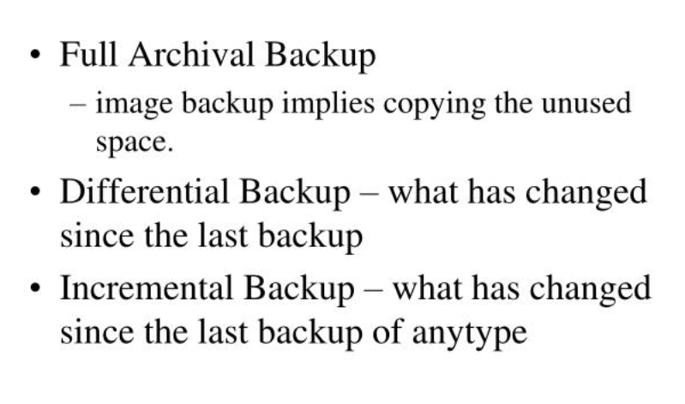
Backup Granularity

Slide 8
Restoring from Cumulative Backup
Monday
Tuesday
Wednesday
Thursday
Friday
Files 1, 2, 3
File 4
Files 4, 5
Files 4, 5, 6
Files 1, 2, 3, 4, 5, 6
Full Backup
Cumulative
Cumulative
Cumulative
Production
Key Features
  More files to be backed up, therefore it takes more time to backup
  and uses more storage space
  Much faster restore because only the last full and the last cumulative
  backup must be applied
Notes:
Copyright © 2009 EMC Corporation. Do not Copy - All Rights Reserved.

Slide 9
Restoring from Incremental Backup
Monday
Tuesday
Wednesday
Thursday
Friday
Files 1, 2, 3
File 4
Updated File 3
File 5
Files 1, 2, 3, 4, 5
Full Backup
Incremental
Incremental
Incremental
Production
Key Features
  Files that have changed since the last backup are backed up
  Fewest amount of files to be backed up, therefore faster backup and less storage space
  Longer restore because last full and all subsequent incremental backups must be applied
Notes:
Copyright © 2009 EMC Corporation. Do not Copy - All Rights Reserved.

Slide 10
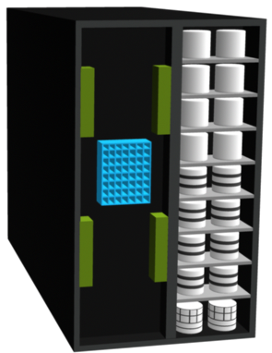
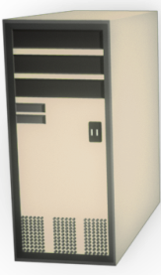
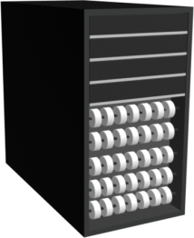
Backup Architecture and Process
Backup client
  Sends backup data to backup server or storage node
Backup server
  Manages backup operations and maintains backup catalog
Storage node
  Responsible for writing data to backup device
Metadata Catalog
Backup Data
Storage Array
Backup Data
Application Server/
Backup Client
Backup Server/
Storage Node
Tape Library
Notes:
Copyright © 2009 EMC Corporation. Do not Copy - All Rights Reserved.

Slide 11
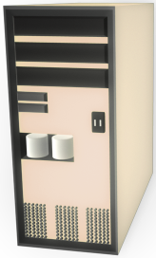
Backup Operation
Application Server and Backup Clients
1
Start of scheduled backup process
2
Backup server retrieves backup related
information from backup catalog
3a
Backup server instructs storage node to
load backup media in backup device
3b
Backup server instructs backup clients to
send its metadata to the backup server
and data to be backed up to storage node
3b
4
4
Backup clients send data to storage node
5
Storage node sends data to backup device
1
3a
5
6
Storage node sends media information to
backup server
2
7
6
7
Backup server update catalog and records
the status
Backup Server
Storage Node
Backup Device
Notes:
Copyright © 2009 EMC Corporation. Do not Copy - All Rights Reserved.

Slide 12
Restore Operation
Application Server and Backup Clients
1
Backup server scans backup catalog
to identify data to be restore and the
client that will receive data
2
Backup server instructs storage node
to load backup media in backup device
3
Data is then read and send to backup
client
4
Storage node sends restore metadata
3
to backup server
5
Backup server updates catalog
1
2
3
5
4
Backup Server
Storage Node
Backup Device
Notes:
Copyright © 2009 EMC Corporation. Do not Copy - All Rights Reserved.

Slide 13
Backup Technology options
Backup to Tape
  Physical tape library
Backup to Disk
Backup to virtual tape
  Virtual tape library
Notes:
Copyright © 2009 EMC Corporation. Do not Copy - All Rights Reserved.

Slide 14
Backup to Tape
Traditional destination for backup
Low cost option
Sequential / Linear Access
Multiple streaming
  Backup streams from multiple clients to a single backup device
Data from
Stream 1
Data from
Stream 2
Data from
Stream 3
Tape
Notes:
Copyright © 2009 EMC Corporation. Do not Copy - All Rights Reserved.

Slide 15
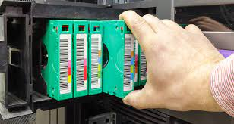
Physical Tape Library
Notes:
Copyright © 2009 EMC Corporation. Do not Copy - All Rights Reserved.

Slide 16
Tape Limitations
Reliability
  Restore performance
    Mount, load to ready, rewind, dismount times
Sequential Access
Cannot be accessed by multiple hosts simultaneously
Controlled environment for tape storage
Wear and tear of tape
Shipping/handling challenges
Tape management challenges
Notes:
Copyright © 2009 EMC Corporation. Do not Copy - All Rights Reserved.

Slide 17
Backup to Disk
Ease of implementation
Fast access
More Reliable
Random Access
Multiple hosts access
Enhanced overall backup and recovery performance
Notes:
Copyright © 2009 EMC Corporation. Do not Copy - All Rights Reserved.

Slide 18
Tape versus Disk – Restore Comparison
Disk
Backup / Restore
24
Minutes
Tape
Backup / Restore
108
Minutes
0
10
20
30
40
50
60
70
80
90
100
110
120
Recovery Time in Minutes*
*Total time from point of failure to return of service to e-mail users
Typical Scenario:
  800 users, 75 MB mailbox
  60 GB database
Source: EMC Engineering and EMC IT
Notes:
Copyright © 2009 EMC Corporation. Do not Copy - All Rights Reserved.

Slide 19





Virtual Tape Library
Backup Server/
Storage Node
FC SAN
LAN
Virtual Tape Library Appliance
Emulation Engine
Storage (LUNs)
Backup Clients
Notes:
Copyright © 2009 EMC Corporation. Do not Copy - All Rights Reserved.

Slide 20
Tape Versus Disk Versus Virtual Tape
 | Tape | Disk-Aware Backup-to-Disk | Virtual Tape
Offsite Capabilities | Yes | No | Yes
Reliability | No inherent protection methods | RAID, spare | RAID, spare
Performance | Subject to mechanical operations, load times | Faster single stream | Faster single stream
Use | Backup only | Multiple (backup/production) | Backup only
Notes:
Copyright © 2009 EMC Corporation. Do not Copy - All Rights Reserved.
RAID - redundant array of independent disks

Slide 21
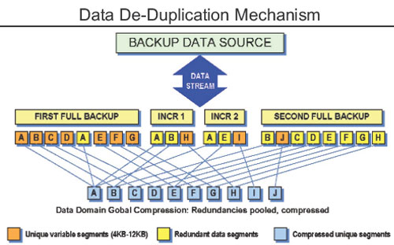
Data De-duplication
Data de-duplication refers to removal of redundant data. In the de-duplication process, a single copy of data is maintained along with the index of the original data, so that data can be easily retrieved when required. Other than saving disk storage space and reduction in hardware costs, (storage hardware, cooling, backup media, etc), another major benefit of data de-duplication is bandwidth optimization.
Notes:
Copyright © 2009 EMC Corporation. Do not Copy - All Rights Reserved.
No matter what kind of business are you in, your data is bound to grow. This makes you add to your storage space continually. However, at times multiple copies of the same data seem to occupy your storage pool. For instance, a presentation which talks about the products of your company might be stored by various users in various departments in your company, resulting in wastage of storage space. Adding to this is the fact that whenever you take the backup of your primary storage device, multiple copies of the same data get duplicated again on the backup storage, be it a tape or a disk based storage. You can do away with all this duplication with the help of data de-duplication technologies.
Data de-duplication refers to removal of redundant data. In the de-duplication process, a single copy of data is maintained along with the index of the original data, so that data can be easily retrieved when required. Other than saving disk storage space and reduction in hardware costs, (storage hardware, cooling, backup media, etc), another major benefit of data de-duplication is bandwidth optimization.
Data de-duplication can be deployed in two ways -source based and target based. The source based de-duplication is done before the backup i.e, at primary storage such as NAS, while in target method, de-duplication is done after the backup. However, in a target based method, de-duplication can also be during the backup, which is known as inline de-duplication. The benefit of in-line deduplication over post-process deduplication is that it requires less storage as data is not duplicated unlike post-process de-duplication.
Source based data de-duplication is usually deployed in environments such as, file-systems, remote branch office environments and virtualization environments. In remote backup scenario, the source based data de-duplication also means that there will be less data traveling through the WAN pipe, resulting in effective bandwidth utilization. Target based de-duplication is a good option where bandwidth is not an issue, such as SAN or LAN backup environments.
How it works?
Largely, there are three techniques used by data de-duplication vendors, file level, block level and byte level. File level de-duplication, also known as single instance stores (SIS), searches for identical files on the disk and eliminates identical ones. The biggest drawback of this method is that if the same file is present with two different names, it won't be eliminated. Block level de-duplication works at more granular level as compared to file level de-duplcation. Here data is broken down to blocks which can be any logical or fixed length blocks and the de-duplication solution looks for unique blocks (most solutions do this by calculating hash). When a unique block is stored, its identifier is created in the index. Now, whenever a repeated block comes across, instead of storing the entire block, a pointer to the existing block is placed in the index thus saving the storage space. Block level de-duplication offers various advantages over the file level de-duplication. The same file with two different names not removed by file based de-duplication will be easily removed in block level de-duplication. Also, if only a part of the file is modified, the modified part will be stored uniquely as compared to the entire data.
Byte level data de-duplication is mostly used in post-processing scenarios. Here, new data is compared at byte level with already existing data and only the changes are stored. Byte level de-duplication can deliver accurate backups. As byte by byte comparison is time consuming, which is the precise reason de-duplication is done after backup, but before data is finally written. However, the catch here is that, this requires extra disk space, to ensure there is enough space for de-duplication to be done while data is on hold. For block level de-duplication to work effectively, data needs to be broken into very small chunks, mostly around 8kb. The drawback here is, the smaller the block size, the more the entires in hash table, and handling the table in itself can become a challenge. Compare to this, byte level stores data in large segments, mostly around 100MB.
Benefits
In an enterprise, most redundant data comes from backing the same data again and again. Depending upon the environment and type de-duplication technology used. Vendors claim, enterprises can achieve de-duplication ratio of 50:1 in source based scenario, and 20:1 in target based scenario. However, before choosing a particular solution, it's important to find out which technologies will suit your current environment and what are your priorities. For instance, are you looking to cut down your WAN costs along with the storage costs? Also a target based de-duplication can come as an add-on to your existing data backup solution. However, for source based, you might need to deploy the solution from the scratch. Last but not the least, data de-duplication is also considered as a green technology as reduction in storage space also means less power consumption and reduction in carbon emission.

Slide 22

Any Questions …..

Slide 23

THANK YOU ☺
The End

